Slide 1
Project name: Predicting Strong Growth in UK Car Registrations Using DfT VEH0160
GitHub link:
https://github.com/SunkeAnandasai3784/SMMT-2025-UK-Car-Sales-Analysis
Student :Anandasai Sunke ID:24057259

Slide 2

Title: Introduction & Project Overview
What I am doing
Using the DfT df_VEH0160_UK Cars dataset to detect quarters where each manufacturer experiences strong positive growth in new registrations.
Designing a realistic binary target and training a tuned Random Forest model using lagged registrations and moving‑average features.​
Why I am doing it
To help manufacturers and analysts understand where demand for a brand is accelerating, not just the absolute level of registrations.​
To practice a full end‑to‑end ML pipeline on an official UK government dataset: EDA, feature engineering, model training and evaluation.
Importance to companies
Strong‑growth flags can support decisions on production planning, stock allocation and marketing focus.​
Gives a forward‑looking, data‑driven signal instead of relying only on past totals.​
Overview of methods
Steps: reshape df_VEH0160_UK into a Make–quarter panel, engineer lag and moving‑average features, define a strong‑growth label, and train/validate/test a Random Forest classifier.​
Use EDA heat maps, learning curves and ROC curves to understand data structure and model behaviour.​

Slide 3
Dataset & Ethical Considerations
DfT df_VEH0160_UK (main dataset)
Type: CSV table ‘Vehicles registered for the first time by body type, make, generic model and model: United Kingdom’, with one column per quarter.
Scope used: filtered to BodyType = “Cars”, then melted to a Make–Quarter long format and aggregated to a Make–Date panel. Final panel after feature engineering: 4,211 Make–quarter observations.​
Time span: approximately 2014 Q3 to 2025 Q3.
What this data is: counts of new car registrations per Make and quarter, used to detect strong year‑on‑year growth periods.
Using data in training
Input features: Registered_lag1, Registered_lag2, Registered_lag4 (1, 2 and 4‑quarter lags) and MA3 (3‑quarter moving average).​
Binary target: Target = 1 if growth_rate = YoY_Growth / |Registered_lag4| > 10%; Target = 0 otherwise. ​
Ethical implications
Data is aggregated by manufacturer and quarter with no personal identifiers, so there are minimal privacy risks.​
Predictions should be interpreted as analytical support for planning, not as financial advice or precise sales forecasts.

Slide 4
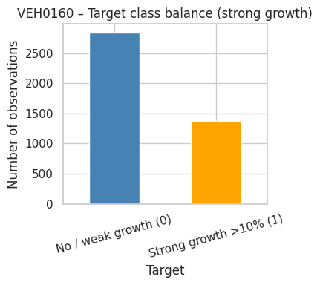
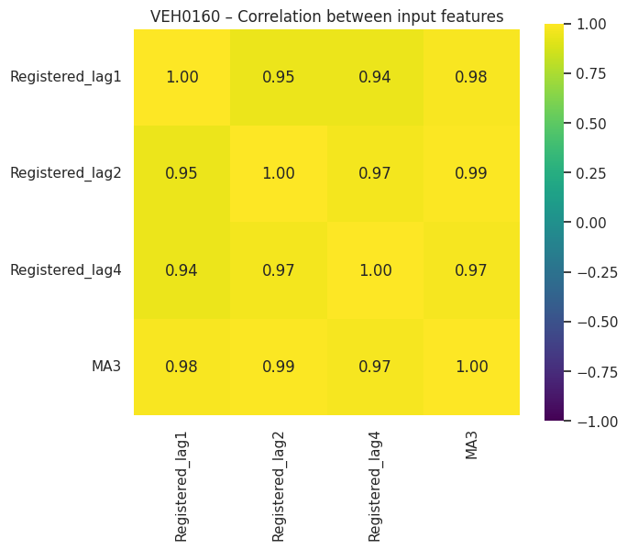
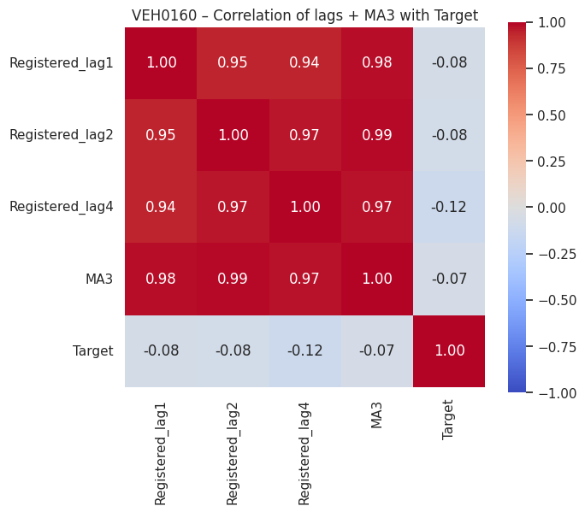
EDA: Class Balance & Heat Maps
Binary target distribution
Target = 1 (strong growth >10% YoY) in about 32.5% of panel rows; Target = 0 (no/weak growth) in about 67.5%, giving a moderately imbalanced dataset.​
Class balance bar chart confirms enough examples in both classes for training and evaluation.​
Heat map: inputs + Target
Correlation heat map of Registered_lag1, Registered_lag2, Registered_lag4, MA3 and Target shows very strong positive correlations among the lags and MA3 (0.94–0.99), but only weak negative correlations around −0.07 to −0.12 with Target.​
This indicates that the strong‑growth label is not directly determined by any single lag feature, which explains why ROC‑AUC is ≈0.78 and not 1.0.​
Heat map: inputs only
Second heat map (features only) highlights multicollinearity: registrations in neighboring quarters and the moving average move almost together.​
This supports using Random Forest, which can handle correlated inputs better than ordinary least squares or simple logistic regression.​
What I am doing in EDA
Using EDA to check that the target is non‑trivial, to identify which features are informative, and to make sure there is no obvious label leakage (e.g., re‑using YoY_Growth directly as an input).​

Slide 5
Pre‑processing & Train–Test Strategy
Time‑series pre‑processing
Filtered df_VEH0160_UK to Cars, melted quarterly columns into long format, parsed ‘Year’ and ‘QuarterNo’ and created a Date at the end of each quarter.​
Aggregated registrations at Make–Date level and sorted by Make and Date to create a panel suitable for lag features.​
Feature engineering
Computed Registered_lag1, Registered_lag2 and Registered_lag4 using within‑Make shifts, plus MA3 as a 3‑quarter moving average.​
Calculated YoY_Growth and growth_rate, then defined the strong‑growth Target using a >10% threshold.​
Train–validation–test split
Cleaned infinities and missing values, then performed a stratified split into 56.25% train, 18.75% validation and 25% test on the engineered panel.​
Used validation set for baseline vs tuned model comparison, and kept the test set completely held out for final evaluation.

Slide 6
Model: Random Forest Classifier
Goal and inputs
Goal: predict whether a Make–quarter is a strong‑growth quarter (Target = 1) using lagged registrations and MA3 as input features.​
Inputs: Registered_lag1, Registered_lag2, Registered_lag4 and MA3; Output: Target ∈ {0,1}.​
Model basics
Chosen model: RandomForestClassifier, an ensemble of many shallow decision trees trained on bootstrap samples of the data.​
Each tree votes for class 0 or 1; the forest averages these votes, giving robust predictions and built‑in non‑linearity.​
Baseline implementation (code snippet)
rf_base = RandomForestClassifier(n_estimators=50, max_depth=4, min_samples_leaf=5, random_state=42, class_weight="balanced")
rf_base.fit(X_train, y_train)​
Why this model
RF naturally handles correlated numeric inputs, provides feature importance, and is easier to tune and explain than more complex deep‑learning models for this structured data.

Slide 7
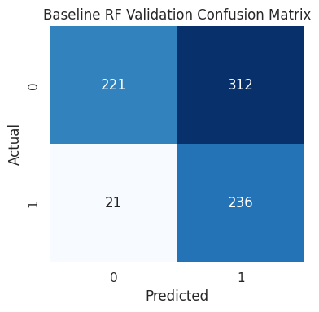
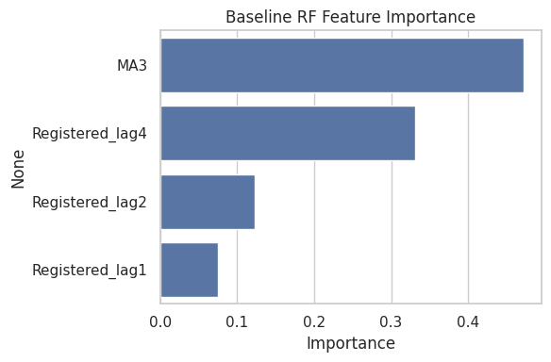
Baseline RF: Metrics, Confusion & Curves
Overall performance
Baseline RF achieves ROC‑AUC ≈ 0.815 on train and ≈ 0.764 on validation, with validation accuracy ≈ 57.8%.​
The gap between train and validation AUC shows moderate overfitting but still good generalisation.​
Confusion matrix behaviour
For the growth class (1), recall is very high (≈0.918) but precision is lower (≈0.431), meaning the baseline model catches most strong‑growth quarters but allows many false positives.​​
For class 0, precision ≈0.913 and recall ≈0.415, which reflects the trade‑off between missing growth and raising false alarms.​​
Feature importance
Baseline feature importance ranks MA3 highest, followed by Registered_lag4, then Registered_lag2 and Registered_lag1.​
This aligns with the idea that both long‑term and recent registration levels are key indicators for strong growth.​
Learning curve
Learning curve shows train ROC‑AUC starting around 0.87 for small training sizes and converging toward 0.80, while validation ROC‑AUC stays around 0.75–0.76.​
This shape suggests the model benefits from more data but cannot reach perfect separation, which is realistic for noisy market data.

Slide 8
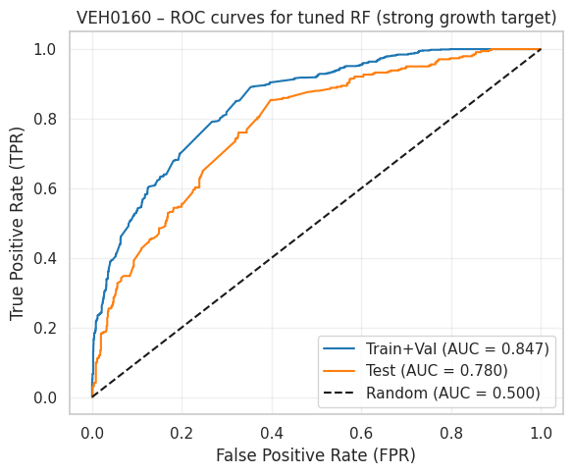
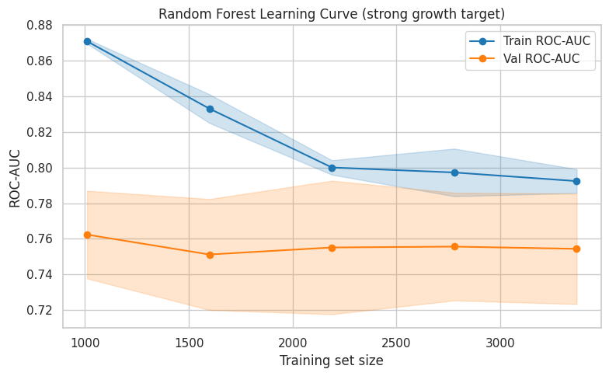
Hyper‑parameter Tuning: Random Forest
Where and how tuning was applied
Used GridSearchCV with 5‑fold cross‑validation on the training set, using ROC‑AUC as the scoring metric.​
Search grid: n_estimators ∈ {30, 60}, max_depth ∈ {3, 4, 5}, min_samples_split ∈ {4, 6}, min_samples_leaf ∈ {3, 5}, max_features = "sqrt".​
Best parameters and CV score
Best parameters: max_depth = 5, n_estimators = 60, min_samples_split = 4, min_samples_leaf = 3, max_features = "sqrt".​
Best cross‑validated ROC‑AUC ≈ 0.807, slightly better and more stable than the baseline configuration.​
Validation and test metrics after tuning
Tuned RF: validation ROC‑AUC ≈ 0.795, test ROC‑AUC ≈ 0.780, with accuracy ≈ 61% on both validation and test sets.​
Log loss decreases compared with baseline, indicating better probability calibration.​
Comparison
Tuning improves AUC by around 0.03 on validation, while maintaining the same high recall for the strong‑growth class and improving overall F1‑scores slightly.

Slide 9
Analysis: Are the Results Satisfactory?
Expectations vs results
Expected ROC‑AUC between 0.7 and 0.85 for this noisy growth prediction problem; tuned RF delivers ≈0.80, which matches this expectation.​
Accuracy around 60% may look modest, but ROC‑AUC ≈0.78 shows that the model ranks strong‑growth quarters substantially better than random.​​
Do they make sense?
Rapid growth is driven by a combination of past levels and short‑term trends, so imperfect performance is realistic; a model that predicts all surges perfectly would be suspicious.​
Feature‑importance ranking and ROC curve shapes align with the understanding that MA3 and annual lags (Registered_lag4) are most influential.
What went wrong / limitations
An earlier version of the notebook included YoY_Growth directly in X and used a weaker target definition, leading to unrealistic perfect scores; this was corrected by redefining the target and removing that feature.​
Remaining limitations: only internal lag features are used (no external economic or policy variables), and the 10% threshold for strong growth is somewhat arbitrary.​
Plans to make it better
Explore additional features such as fuel‑type splits or macro indicators and compare RF with gradient boosting or time‑series models such as Prophet and LSTM.

Slide 10
Summary, Conclusion & Next Steps
Summary
Applied a Random Forest model to the df_VEH0160_UK Cars panel to predict a strong‑growth binary target from lagged registrations and MA3 features.
Achieved validation ROC‑AUC ≈ 0.795 and test ROC‑AUC ≈ 0.780 after careful feature engineering, target design and hyper‑parameter tuning.​​
Best result
The tuned Random Forest with 60 trees, max depth 5, min samples leaf 3 and min samples split 4 provided the best balance between recall for strong‑growth quarters and generalization on unseen data.​
FPR and thresholds
ROC curves show that by moving the probability threshold we can trade off false positive rate (FPR) against true positive rate (TPR), choosing either a more aggressive growth detector or a more conservative one depending on business preference.​
Next steps
Extend the approach to include added explanatory variables and alternative models and integrate the predictions into a simple dashboard where stakeholders can monitor strong‑growth signals by manufacturer and quarter.
Overall, the project proves that a well‑designed Random Forest using official DfT registration data can deliver realistic and interpretable signals about which UK car manufacturers are gaining momentum.

